Slide 1


Rejuvenating the SIM: Reconfiguration Policies
Research Meeting

Slide 2
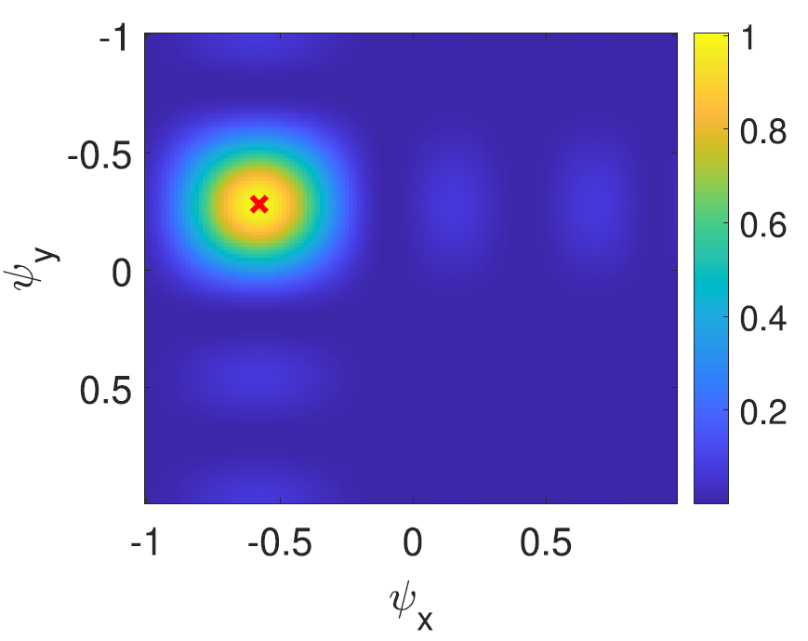


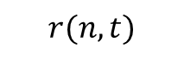
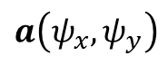
Localization Scenario
$$r(n,t)$$
Signal Processing
$$a\left(ψ_{x},ψ_{y}\right)$$
Mobile
User
P. Heidenreich, A. M. Zoubir and M. Rubsamen, "Joint 2-D DOA Estimation and Phase Calibration for Uniform Rectangular Arrays," in IEEE Transactions on Signal Processing, vol. 60, no. 9, pp. 4683-4693, Sept. 2012, doi: 10.1109/TSP.2012.2203125.

Slide 3
Localization Scenario
$$r(n,t)$$
SIM
2D-Discrete Fourier Transform
Signal Processing
$$a\left(ψ_{x},ψ_{y}\right)$$
Mobile
User
J. An et al., "Two-Dimensional Direction-of-Arrival Estimation Using Stacked Intelligent Metasurfaces," in IEEE Journal on Selected Areas in Communications, vol. 42, no. 10, pp. 2786-2802, Oct. 2024.

Slide 4
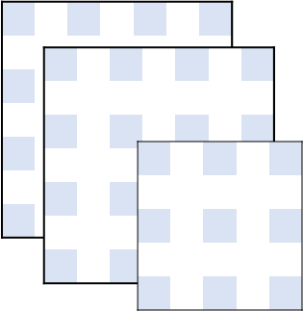
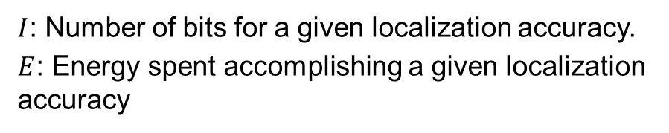
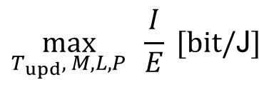
Problem Formulation
Variables
Performance
Relative errors for localization
Complexity
Number of SIM layers
Overhead
Localization
SIM Configuration
SIM
Mobile
User
Problem Formulation
$$\max_{T_{upd}, M, L, P}{ \frac{I}{E} [bit/\text{J}]}$$
$I$: Number of bits for a given localization accuracy.
$E$: Energy spent accomplishing a given localization accuracy

Slide 5
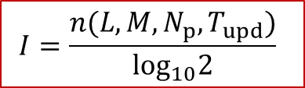
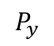

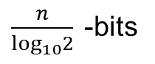
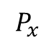
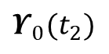
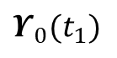
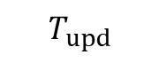
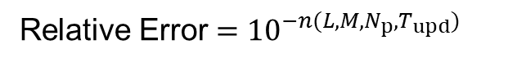
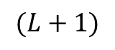
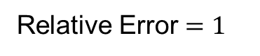
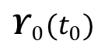
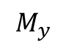
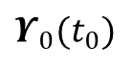
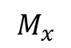

Problem Formulation
Variables
SIM
Performance
Relative error for localization
Complexity
Number of SIM layers
Overhead
Localization
SIM Configuration
$$I=\frac{n(L,M,N_{p},T_{upd})}{\log_{10}2}{ }$$
$$(L+1)$$
$$P_{y}$$
$$M_{y}$$
$$P_{x}$$
$$M_{x}$$
$$T_{upd}$$
Relative Error $=1$
Relative Error $={10}^{−n(L,M,N_{p},T_{upd})}$
$$Υ_{0}(t_{0})$$
$$Υ_{0}(t_{1})$$
$$Υ_{0}(t_{2})$$
$$⋯$$
$$Υ_{0}(t_{0})$$
Magnitude
$$t$$
Mobile
User
Bits
1-bit
$\frac{n}{\log_{10}2}{ }$-bits

Slide 6
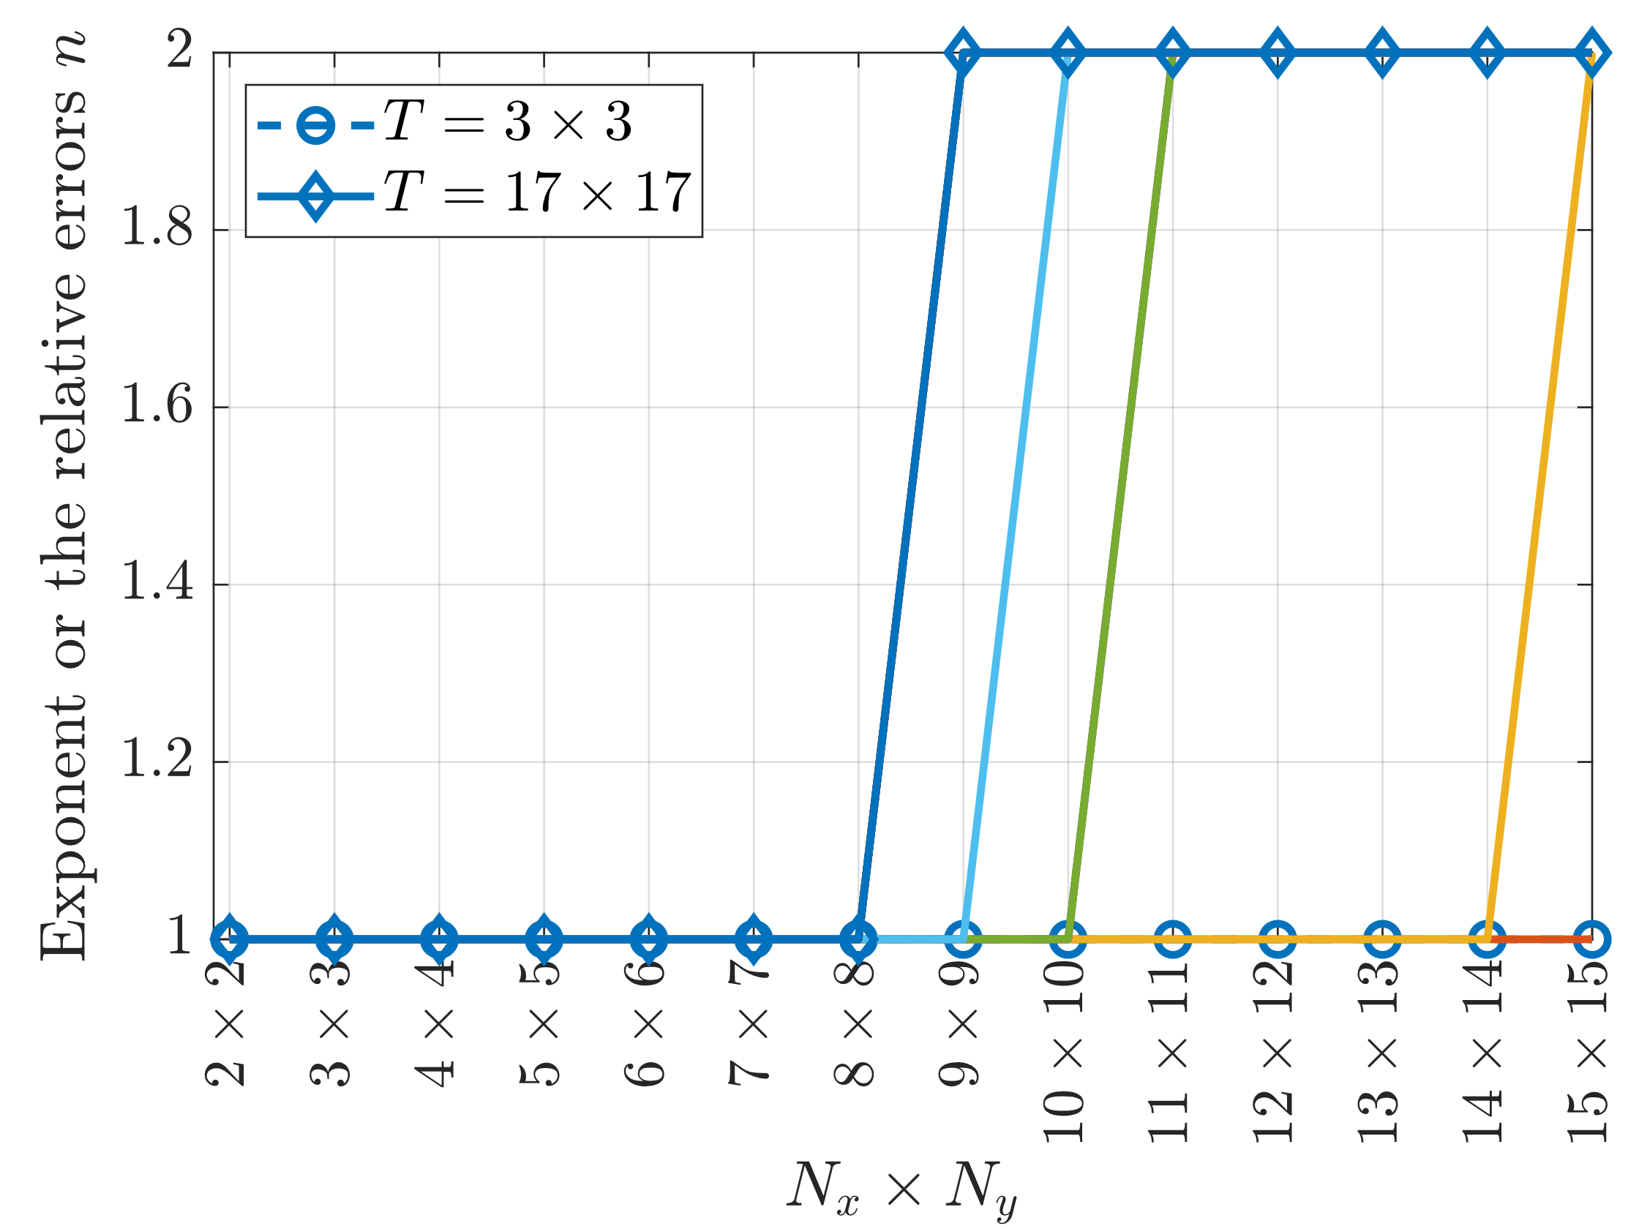
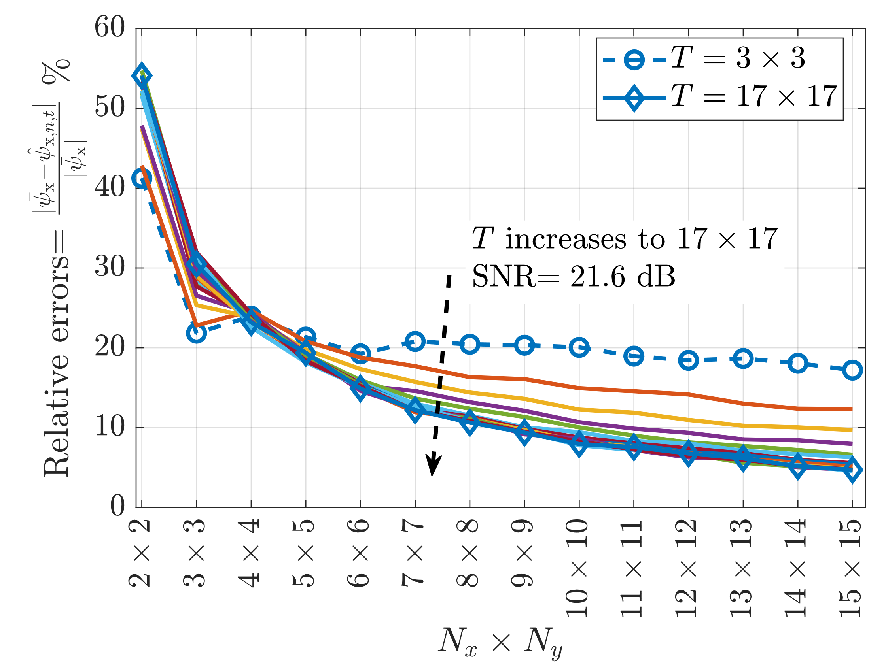
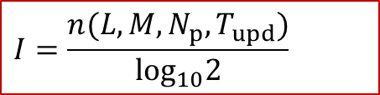

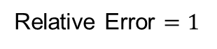
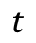
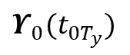
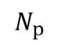
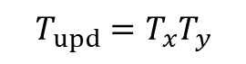
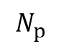
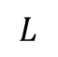
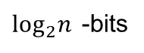
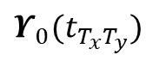
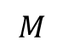
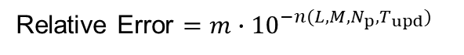
Relative Error Formulation
Performance
Relative error for localization
$$I=\frac{n(L,M,N_{p},T_{upd})}{\log_{10}2}{ }$$
$$L$$
(1)
$$M$$
SIM
Relative Error $=m∙{10}^{−n(L,M,N_{p},T_{upd})}$
(2)
$$N_{p}$$
Relative Error $=1$
$$N_{p}$$
Magnitude
$$T_{upd}=T_{x}T_{y}$$
Bits
1-bit
$\log_{2}n{ }$-bits
(3)
$$Υ_{0}(t_{0T_{y}})$$
$$⋯$$
$$Υ_{0}(t_{T_{x}T_{y}})$$
$$t$$
Mobile
User

Slide 7
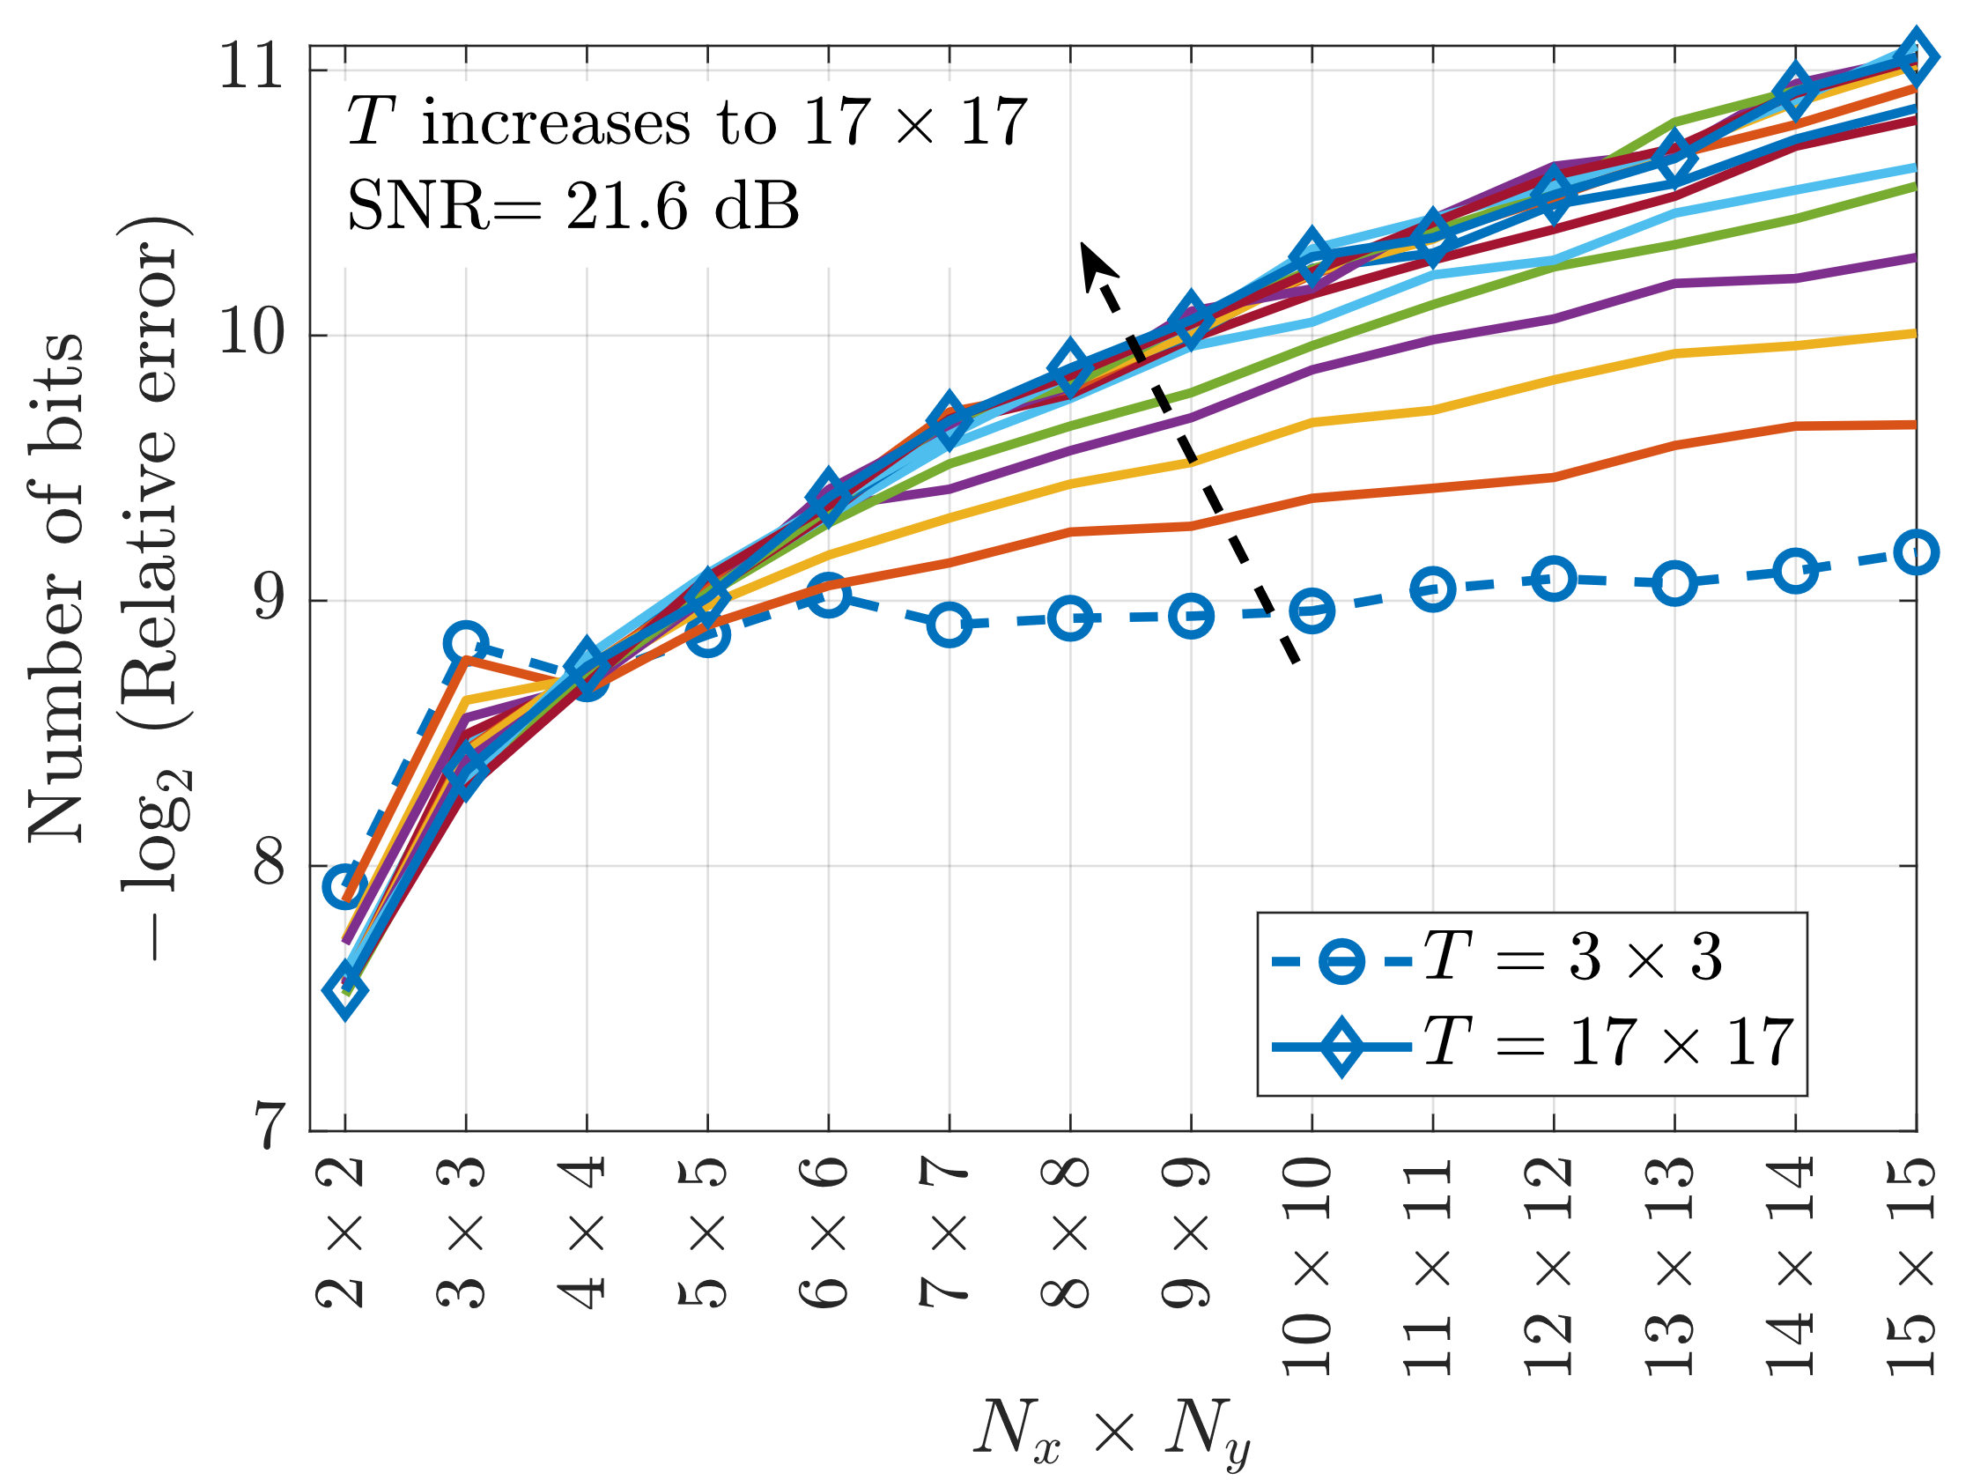
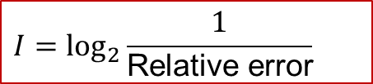
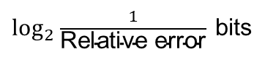
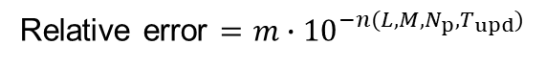
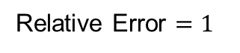
Relative Error Formulation
Performance
Relative error for localization
$$I=\log_{2}\frac{1}{\text{Relative} \text{e}\text{rror}}{ }{ }$$
$$L$$
(1)
$$M$$
SIM
$$N_{p}$$
$$N_{p}$$
Relative Error $=1$
Relative error $=m∙{10}^{−n(L,M,N_{p},T_{upd})}$
(2)
$$T_{upd}=T_{x}T_{y}$$
Magnitude
Bits
$$Υ_{0}(t_{0T_{y}})$$
$$⋯$$
$$Υ_{0}(t_{T_{x}T_{y}})$$
0-bit
$\log_{2}\frac{1}{\text{Relative} \text{e}\text{rror}}{ }$bits
(3)
$$t$$
Mobile
User

Slide 8
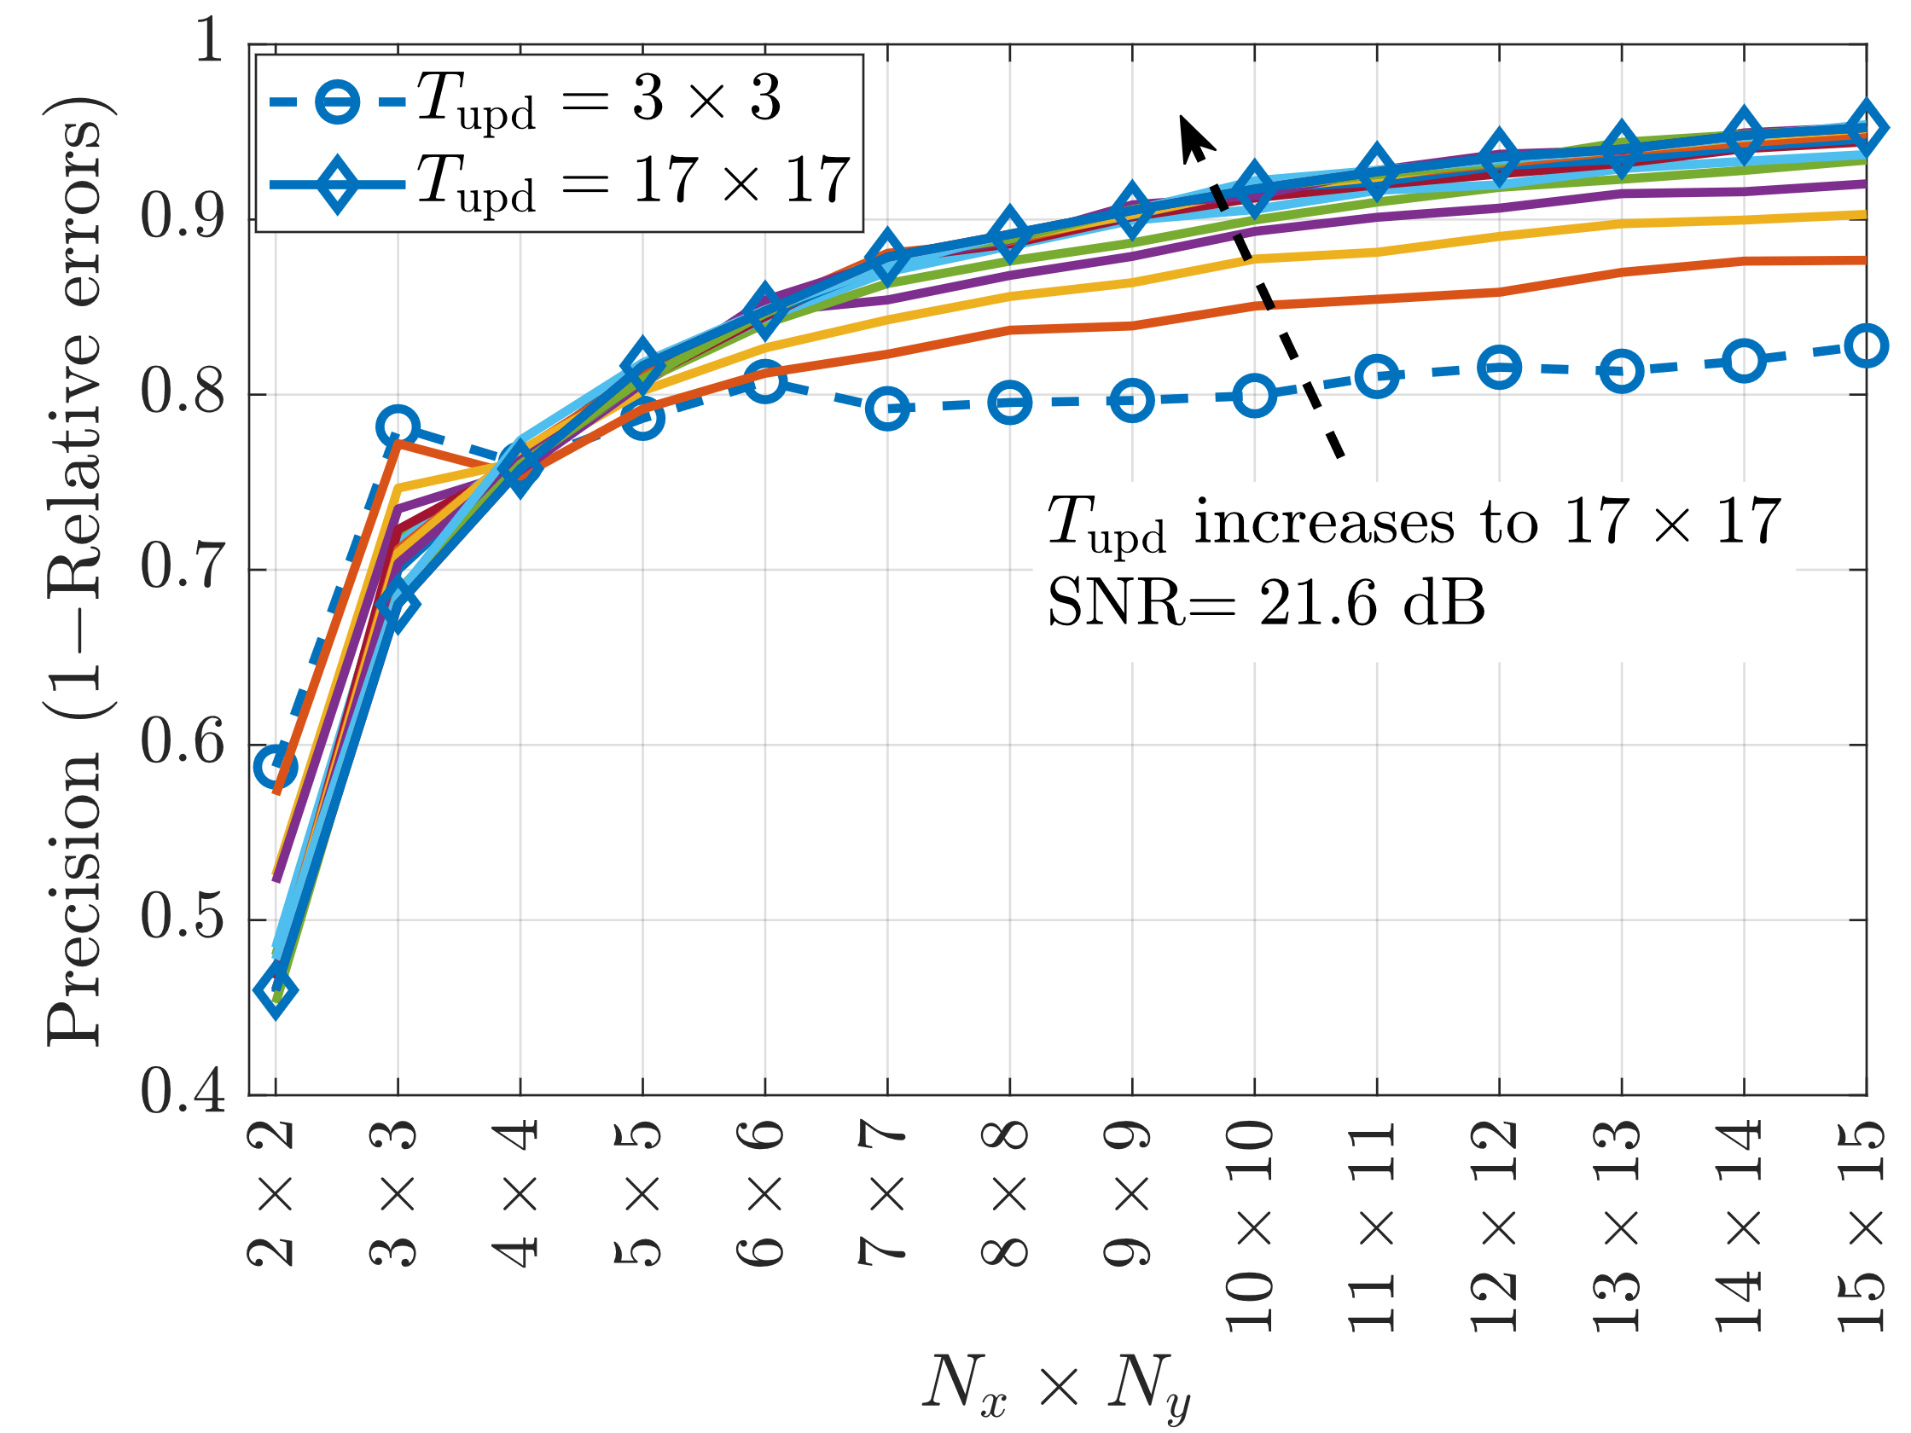
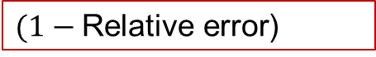
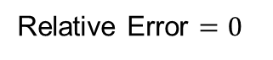

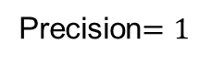
Relative Error Formulation
Performance
Precision for localization
$$(1−\text{Relative} \text{e}\text{rror}\text{)}$$
$$L$$
(1)
$$M$$
SIM
Relative Error $=1$
Relative Error $=0$
(2)
$$N_{p}$$
$$N_{p}$$
$$T_{upd}=T_{x}T_{y}$$
Precision $=0$
Precision$=1$
$$Υ_{0}(t_{0T_{y}})$$
$$⋯$$
$$Υ_{0}(t_{T_{x}T_{y}})$$
$$t$$
Mobile
User

Slide 9
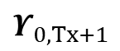
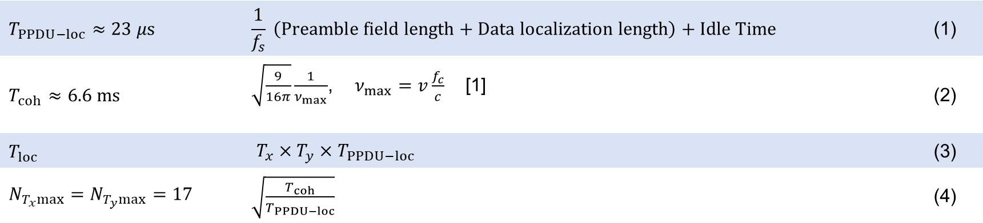

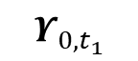

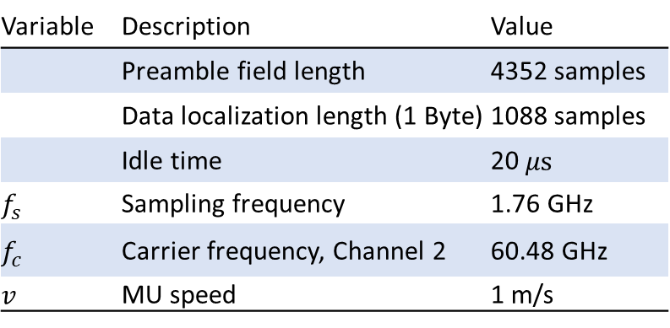
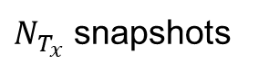

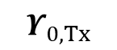
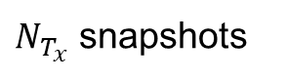




Performance (WiFi 802.11ad)
$N_{T_{y}}$ snapshots
Variable | Description | Value
 | Preamble field length | 4352 samples
 | Data localization length (1 Byte) | 1088 samples
 | Idle time | 20 $μs$
$$f_{s}$$ | Sampling frequency | 1.76 GHz
$$f_{c}$$ | Carrier frequency, Channel 2 | 60.48 GHz
$v$ | MU speed | 1 m/s
$N_{T_{x}}$ snapshots
$N_{T_{x}}$ snapshots
$$Υ_{0,t_{1}}$$
$$⋯$$
$$Υ_{0,Tx}$$
$$Υ_{0,Tx+1}$$
$$⋯$$
$$⋯$$
$$Υ_{0,TxTy}$$
$$t$$
$$T_{PPDU−loc}$$
$$T_{PPDU−loc}≈23 μs$$ | $$\frac{1}{f_{s}} \left(Preamble field length+Data localization length\right)+Idle Time$$ | (1)
$T_{coh}≈6.6 ms$ | $\sqrt{\frac{9}{16π}}\frac{1}{ν_{max}}$, $ν_{max}=v\frac{f_{c}}{c}$ [1] | (2)
$T_{loc}$ | ${T_{x}×T_{y}×T}_{PPDU−loc}$ | (3)
$N_{T_{x}max}=N_{T_{y}max}=17$ | $\sqrt{\frac{T_{coh}}{T_{PPDU−loc}}}$ | (4)
[1] T. S. Rappaport, Wireless Communications: Principles and Practice, 2nd ed. Upper Saddle River, NJ: Prentice Hall, 2009. (Eq. 4.40 c)

Slide 10







SIM
$$θ$$
$$z$$
$$φ$$
Input Layer $N_{x}×N_{y}$
$$y$$
Mobile
User
$$x$$

Slide 11



Parameters
SIM
 | Variable | Description | Value
Frame parameters |  | Preamble field length | 4352 samples
 |  | Data localization length (1 Byte) | 1088 samples
 |  | Training field length | 0 samples
 |  | Idle time | 20 $μs$
 | $$N$$ | Total of SIM elements (Layer 0) | 5$×$5
RF parameters | $$f_{s}$$ | Sampling frequency | 1.76 GHz
 | BW | Receiver bandwidth | 2640 MHz
 | $$f_{c}$$ | Carrier frequency, Channel 2 | 60.48 GHz
 | $$P_{Tx}$$ | Transmitter peak power | 20 dBm
 |  | Number of transmitter antennas | 1
 |  | Number of beams | 1
 |  | Gain per beam | 9 dBi
 | NF | Noise figure | 7 dB
 | $$N_{0}$$ | Thermal noise density | 174 dBm/Hz
 | $$N_{int}$$ | Receiver interference density | -165.7 dBm/Hz
 | $$P_{N}$$ | Noise Floor | $≈$-70 dBm
 | $$p_{SIM}$$ | SIM vector location | [2.5, 2.5, 2.5] m
 | $$p_{MU}$$ | MU initial vector location | [2, 4, 1.5] m
 | $v$ | MU speed | 1 m/s
$$θ$$
$$z$$
Input Layer
$$φ$$
$$y$$
Mobile
User
$$x$$

Slide 12


DoA methods
SIM
Beamformers
$y\left(t\right)=w^{H}x\left(t\right)$
Spatial: $P\left(φ\right)=\frac{1}{N}\sum{{\left|y(t)\right|}^{2}}$
Barlett:$w=\frac{a(φ)}{\sqrt{a^{H}(φ)a(φ)}}$
Capon: $w=\frac{R^{−1}a(φ)}{a^{H}(φ)R^{−1}a(φ) }$
Subspace-based methods
MUSIC: $P(φ)=\frac{a^{H}(φ) a(φ)}{a^{H}\left(φ\right)Π a(φ)}$
ESPRIT: $φ=arcsin\left(\frac{λθ}{2πd}\right)$
[1] H. Krim and M. Viberg, “Two decades of array signal processing research: the parametric approach,” IEEE Signal Processing Magazine, vol. 13, no. 4, pp. 67–94, Jul. 1996, doi: 10.1109/79.526899.
[2] S. A. (Reza) Zekavat, “An Introduction to Direction-of-Arrival Estimation Techniques,” in Handbook of Position Location, John Wiley & Sons, Ltd, 2018, pp. 303–341. doi: 10.1002/9781119434610.ch9.

Slide 13







Fast-tracking Algorithm
SIM
Mobile
User
$$T_{upd}$$
$$Υ_{0}(t_{0})$$
$$Υ_{0}(t_{1})$$
$$⋯$$
$$Υ_{0}(t_{0})$$
$$t$$
J. An et al., "Two-Dimensional Direction-of-Arrival Estimation Using Stacked Intelligent Metasurfaces," in IEEE Journal on Selected Areas in Communications, vol. 42, no. 10, pp. 2786-2802, Oct. 2024.

Slide 14








Fast-tracking Algorithm
SIM 2
Neural
Network
$$𝕴\left(t\right)$$
SIM 1
$$∆t$$
Mobile
User
$$T_{upd}$$
$$Υ_{0}(t_{0})$$
$$Υ_{0}(t_{1})$$
$$⋯$$
$$Υ_{0}(t_{0})$$
$$t$$
J. An et al., "Two-Dimensional Direction-of-Arrival Estimation Using Stacked Intelligent Metasurfaces," in IEEE Journal on Selected Areas in Communications, vol. 42, no. 10, pp. 2786-2802, Oct. 2024.

Slide 15















Relative Error Formulation
Performance
Relative error for localization
$$I=\frac{n(L,M,N_{p},T_{upd})}{\log_{10}2}{ }$$
(1)
SIM
Relative Error $=1$
Relative Error $={10}^{−n(L,M,N_{p},T_{upd})}$
(2)
$$L$$
$$M$$
Magnitude
$$N_{p}$$
$$N_{p}$$
Bits
1-bit
$\frac{n}{\log_{10}2}{ }$-bits
(3)
$${MSE}_{ψ_{x}}≤\sum_{n=1}^{N}{\sum_{t=1}^{T}{{\left({\overline{ψ}}_{x}−{\hat{ψ}}_{x,n,t}\right)}^{2}×Q(b_{n,t},h_{n,t})}}$$
$$T_{upd}=T_{x}T_{y}$$
(4)
$$Υ_{0}(t_{0})$$
$$Υ_{0}(t_{1})$$
$$⋯$$
$$Υ_{0}(t_{0})$$
$${Relative Error}_{ψ_{x}}≤\frac{1}{X}\sum_{x=1}^{X}{\sum_{n=1}^{N}{\sum_{t=1}^{T}{\frac{\left|{\overline{ψ}}_{x}−{\hat{ψ}}_{x,n,t}\right|}{\left|{\overline{ψ}}_{x}\right|}×Q(b_{n,t},h_{n,t})}}}$$
$$t$$
(5)
Mobile
User
$$n\left(T_{upd}\right)=\left\lceil \log_{10}\left({Relative Error}_{ψ_{x}}\right)\right\rceil$$
(6)

Slide 16
























Localization Algorithm
$$r(n,t)$$
SIM
$$n_{x}$$
$$9$$
$$3$$
$$2$$
$$Υ_{0}(t)$$
$$a\left(ψ_{x},ψ_{y}\right)$$
$$4$$
$$1$$
$$n$$
$$n_{y}$$
Mobile
User
$$G\sim 2D−Fourier Kernel$$
$$f_{n_{ψ},n }=e^{−j2π\frac{(n_{ψ_{x}}−1)(n_{x}−1)}{N_{x}}}e^{−j2π\frac{(n_{ψ_{y}}−1)(n_{y}−1)}{N_{y}}}$$
$n$: spatial dimension
$n_{\text{ψ}}$: angular dimension
$$n,n_{\text{ψ}}∈\left\{1,2,⋯,N_{x}N_{y}\right\}$$
2
on-grid DOA
spatial freq.
offset
1
$$T_{upd}$$
$n_{y}=\left\lceil \frac{n}{N_{x}}\right\rceil$, $x$-component of the spatial dimension
$$Υ_{0}(t_{0})$$
$$r(n,t)=\sqrt{SNR}GΥ_{0}\left(t\right)a\left(ψ_{x},ψ_{y}\right)s+u$$
$$Υ_{0}(t_{0})$$
$$Υ_{0}(t_{1})$$
$$⋯$$
$$t$$
$n_{x}=n−(n_{y}−1)N_{x}$, $y$-component of the spatial dimension
$$\left[\hat{φ},\hat{θ}\right]=f\left(\underset{n,t}{arg max}{r(n,t)}\right)$$
J. An et al., "Two-Dimensional Direction-of-Arrival Estimation Using Stacked Intelligent Metasurfaces," in IEEE Journal on Selected Areas in Communications, vol. 42, no. 10, pp. 2786-2802, Oct. 2024.

Slide 17













Localization Algorithm
$$r(n,t)=\sqrt{SNR}GΥ_{0}\left(t\right)a\left(ψ_{x},ψ_{y}\right)s+u$$
(1)
$$n_{x}$$
$$a\left(ψ_{x},ψ_{y}\right)={\left[e^{jψ_{x}(n_{x}−1)}\right]⊗\left[e^{jψ_{y}(n_{y}−1)}\right]}_{N×1}$$
(2)
$$9$$
$$3$$
Mobile
User
Step
1
$$2$$
$$4$$
$$1$$
$$n$$
$$n_{y}$$
$$Υ_{0}\left(t\right)=diag\left(e^{−j2π\frac{(t_{x}−1)(n_{x}−1)}{N_{x}T_{x}}}e^{−j2π\frac{(t_{y}−1)(n_{y}−1)}{N_{y}T_{y}}}\right)$$
(3)
$$T_{upd}$$
Step
2
$$Υ_{0}(t_{0})$$
$$Υ_{0}(t_{1})$$
$$Υ_{0}(t_{2})$$
$$⋯$$
$$Υ_{0}(t_{0})$$
$$G={\left[f_{n_{ψ},n }\right]}_{N×N}=\left[e^{−j2π\frac{(n_{ψ_{x}}−1)(n_{x}−1)}{N_{x}}}e^{−j2π\frac{(n_{ψ_{y}}−1)(n_{y}−1)}{N_{y}}}\right]$$
(4)
$$t$$
$${𝕴\left(t\right)}_{N×N}=\left[e^{−j2π\frac{(n_{ψ_{x}}+\frac{t_{x}}{T_{x}}−1−\frac{1}{T_{x}})(n_{x}−1)}{N_{x}}}e^{−j2π\frac{(n_{ψ_{y}}+\frac{t_{y}}{T_{y}}−1−\frac{1}{T_{y}})(n_{y}−1)}{N_{y}}}\right]$$
(5)
$$\left[\hat{φ},\hat{θ}\right]=f\left(\underset{n,t}{arg max}{r(n,t)}\right)$$
(6)
J. An et al., "Two-Dimensional Direction-of-Arrival Estimation Using Stacked Intelligent Metasurfaces," in IEEE Journal on Selected Areas in Communications, vol. 42, no. 10, pp. 2786-2802, Oct. 2024.

Slide 18



Localization Algorithm
$${r\left(n,t\right)}_{N×1}=\sqrt{SNR} {𝕴\left(t\right)}_{N×N}{a\left(ψ_{x},ψ_{y}\right)}_{N×1}s+u$$
(1)
$$n_{x}$$
$$a\left(ψ_{x},ψ_{y}\right)={\left[e^{jψ_{x}(n_{x}−1)}\right]⊗\left[e^{jψ_{y}(n_{y}−1)}\right]}_{N×1}$$
(2)
$$9$$
$$3$$
$${𝕴\left(t\right)}_{N×N}=\left[e^{−j2π\frac{(n_{ψ_{x}}+\frac{t_{x}}{T_{x}}−1−\frac{1}{T_{x}})(n_{x}−1)}{N_{x}}}e^{−j2π\frac{(n_{ψ_{y}}+\frac{t_{y}}{T_{y}}−1−\frac{1}{T_{y}})(n_{y}−1)}{N_{y}}}\right]$$
$$2$$
(3)
$$4$$
$$1$$
$$n$$
Mobile
User
$$n_{y}$$
$$T_{upd}$$
$$Υ_{0}(t_{0})$$
$$Υ_{0}(t_{1})$$
$$⋯$$
$$Υ_{0}(t_{0})$$
$$t$$
$$ψ_{x}=\frac{2πn_{ψ_{x}}}{N_{x}}$$
(4)
$$ψ_{y}=\frac{2πn_{ψ_{x}}}{N_{y}}$$
(5)
J. An et al., "Two-Dimensional Direction-of-Arrival Estimation Using Stacked Intelligent Metasurfaces," in IEEE Journal on Selected Areas in Communications, vol. 42, no. 10, pp. 2786-2802, Oct. 2024.

Slide 19
















Problem Formulation
Variables
SIM
$$(L+1)$$
Performance
Relative errors for localization
Complexity
Number of SIM layers
Overhead
Localization
SIM Configuration
$$M_{y}$$
Energy consumption
$$E=E_{MU}\left(T_{upd}\right)+E_{SIM}(T_{upd},N_{p})$$
$$E_{SIM}$$
$$M_{x}$$
$$E_{MU}$$
$$T_{upd}$$
Mobile
User
$$Υ_{0}(t_{0})$$
$$Υ_{0}(t_{1})$$
$$Υ_{0}(t_{2})$$
$$⋯$$
$$Υ_{0}(t_{0})$$
$$Υ_{0}(t_{1})$$
$$Υ_{0}(t_{2})$$
$$t$$
Notes:
Tunable circuits
[1] C. Liu et al., "A programmable diffractive deep neural network based on a digital-coding metasurface array", Nature Electron., vol. 5, no. 2, pp. 113-122, Feb. 2022.
[2] J. An et al., "Stacked intelligent metasurfaces for efficient holographic MIMO communications in 6G", IEEE J. Sel. Areas Commun., vol. 41, no. 8, pp. 2380-2396, Aug. 2023.
[3] J. An, M. Di Renzo, M. Debbah, H. Vincent Poor and C. Yuen, "Stacked intelligent metasurfaces for multiuser downlink beamforming in the wave domain", arXiv:2309.02687, 2023.

Slide 20














Problem Formulation
Variables
Performance
Relative errors for localization
Complexity
Number of SIM layers
Overhead
Number of packets
SIM re-configuration
$$I=\frac{n(M,L,N_{p},T_{upd})}{\log_{10}2}{ }$$
Energy consumption
$$Υ_{0}(t)$$
$$E=E_{MU}\left(T_{upd}\right)+E_{SIM}(T_{upd},N_{p})$$
$$E_{SIM}$$
$$E_{MU}$$
Mobile
User
$$T_{upd}$$
$$Υ_{0}(t_{0})$$
$$Υ_{0}(t_{1})$$
$$Υ_{0}(t_{2})$$
$$⋯$$
$$Υ_{0}(t_{0})$$
$$Υ_{0}(t_{1})$$
$$Υ_{0}(t_{2})$$
$$t$$

Slide 21






Problem Formulation
Variables
Performance
Relative errors for localization
Complexity
Number of SIM layers
Overhead
Number of packets
SIM re-configuration
$$I=\frac{n(M,L,P,T_{upd})}{\log_{10}2}{ }$$
(1)
Energy consumption
$$E=E_{MU}\left(T_{upd}\right)+E_{SIM}(T_{upd},N_{p})$$
(2)
$$Υ_{0}(t)$$
$$E_{SIM}$$
$$E_{s}$$
Mobile
User
Problem Formulation
$$\max_{T_{upd}, M, L, P}{ \frac{I}{E} [bit/\text{J}]}$$
(3)
$$\max_{T_{upd}, M, L, P }{\frac{n(M,L,P,T_{upd})}{E_{SIM}(M,L,P)+E_{MU}(T_{upd})}}$$
(4)

Slide 22













Energy-consumption model
SIM
$$(L+1)$$
Energy consumption
$$E=E_{MU}\left(T_{upd}\right)+E_{SIM}(T_{upd},N_{p})$$
(1)
$$P_{p}$$
$$M_{y}$$
Protocol
$$T_{upd}$$
$$Υ_{0}(t_{0})$$
$$Υ_{0}(t_{1})$$
$$Υ_{0}(t_{2})$$
$$⋯$$
$$Υ_{0}(t_{0})$$
$$\left(P_{FPGA}+P_{drive−circuit}\right)$$
$$M_{x}$$
$$t$$
$$P_{atom−disip}$$
$E_{MU}\left(T_{upd}\right)=$ $P_{MU}∙T_{upd}$
(2)
$$P_{MU}$$
$E_{SIM}\left(T_{upd}\right)=$ $\left(P_{FPGA}+P_{drive−circuit}+P_{p}\right)∙T_{upd}+P_{a}∙T_{upd}$
(3)
Mobile
User
[1] J. Wang et al., “Reconfigurable Intelligent Surface: Power Consumption Modeling and Practical Measurement Validation,” IEEE Transactions on Communications, vol. 72, no. 9, pp. 5720–5734, Sep. 2024
Notes:
Tunable circuits
[1] C. Liu et al., "A programmable diffractive deep neural network based on a digital-coding metasurface array", Nature Electron., vol. 5, no. 2, pp. 113-122, Feb. 2022.
[2] J. An et al., "Stacked intelligent metasurfaces for efficient holographic MIMO communications in 6G", IEEE J. Sel. Areas Commun., vol. 41, no. 8, pp. 2380-2396, Aug. 2023.
[3] J. An, M. Di Renzo, M. Debbah, H. Vincent Poor and C. Yuen, "Stacked intelligent metasurfaces for multiuser downlink beamforming in the wave domain", arXiv:2309.02687, 2023.

Slide 23










Energy-consumption model: Varactor Diode
Energy consumption
@5GHz
$$E=E_{MU}\left(T_{upd}\right)+E_{SIM}(T_{upd},N_{p})$$
(1)
$E_{SIM}\left(T_{upd}\right)=$ $\left(P_{control−board}+P_{drive−circuit}+P_{p}\right)∙T_{upd}+P_{atom−disip}∙T_{upd}$
(2)
Board | Power
XC7K70T | 4.8 W
ZYNQ7100 | 1.5 W
$$M_{y}$$
$$P_{atom−disip}≈0$$
(4)
$$M_{x}$$
$$P_{control−board}$$
$$P_{unit−circuit}$$
$$P_{drive−circuit}=\left(\left\lceil \frac{\sum_{i=1}^{N}{I_{i,v}}}{N_{g,v}×N_{s}}\right\rceil +\left\lceil \frac{\sum_{i=1}^{N}{I_{i,h}}}{N_{g,h}×N_{s}}\right\rceil \right)∙P_{unit−circuit}$$
(3)
$N$: number of atoms
$$I_{i,v}\left\{\begin{matrix}1 & \text{if} \text{the} \text{i}\text{−}\text{th} \text{atom} is reconfigurable \\ 0 & otherwise\end{matrix}\right.$$
$N_{g,v}$: number of atoms in the same group, where all are configured the same.
$N_{s}$: number of signal generated by the same atom-circuit.
Component | Power
DAC3484 | 250 mW
AD8021 | 180 mW
$$E_{MU}$$
Mobile
User
[1] J. Wang et al., “Reconfigurable Intelligent Surface: Power Consumption Modeling and Practical Measurement Validation,” IEEE Transactions on Communications, vol. 72, no. 9, pp. 5720–5734, Sep. 2024
[2] J. Tong, Z. An, X. Zhao, S. Liao, and L. Yang, “In-Sensor Machine Learning: Radio Frequency Neural Networks for Wireless Sensing,” in Proceedings of the Twenty-fifth International Symposium on Theory, Algorithmic Foundations, and Protocol Design for Mobile Networks and Mobile Computing, in MobiHoc ’24. New York, NY, USA: Association for Computing Machinery, Oktober 2024, pp. 261–270. doi: 10.1145/3641512.3686393.
Notes:
Tunable circuits
[1] C. Liu et al., "A programmable diffractive deep neural network based on a digital-coding metasurface array", Nature Electron., vol. 5, no. 2, pp. 113-122, Feb. 2022.
[2] J. An et al., "Stacked intelligent metasurfaces for efficient holographic MIMO communications in 6G", IEEE J. Sel. Areas Commun., vol. 41, no. 8, pp. 2380-2396, Aug. 2023.
[3] J. An, M. Di Renzo, M. Debbah, H. Vincent Poor and C. Yuen, "Stacked intelligent metasurfaces for multiuser downlink beamforming in the wave domain", arXiv:2309.02687, 2023.

Slide 24







Energy-consumption model: Varactor Diode
SIM
$$(L+1)$$
Energy consumption
$$E=E_{MU}\left(T_{upd}\right)+E_{SIM}(T_{upd},N_{p})$$
(1)
$$P_{p}$$
$$M_{y}$$
$E_{SIM}\left(T_{upd}\right)=$ $\left(P_{control−board}+P_{drive−circuit}+P_{p}\right)∙T_{upd}+P_{atom−disip}∙T_{upd}$
(2)
Item | Component | Value
Control-board | ZYNQ7100 | 1.5 W
Unit-circuit | DAC3484 | 250 mW
 | AD8021 | 180 mW
SIM | Probes | $2×2$
 |  | $4×4$
 | $$L$$ | $7$
 |  | $13$
 | $$M$$ | $121$
 |  | $225$
$$P_{atom−disip}≈0$$
(3)
$$M_{x}$$
$P_{drive−circuit}=\left\{\begin{matrix}4∙P_{unit−circuit}≈1.7 \text{W} & 2×2 \\ 16∙P_{unit−circuit}≈6.8 \text{W} & 4×4 \end{matrix}\right.$
(4)
$$P_{atom−disip}$$
$$E_{MU}$$
Mobile
User
$N$: number of atoms
$$I_{i,v}=\left\{\begin{matrix}1 & \text{if} \text{the} \text{i}\text{−}\text{th} \text{atom} is reconfigurable \\ 0 & otherwise\end{matrix}\right.$$
$N_{g,v}=1$: number of atoms in the same group, where all are configured the same.
$N_{s}=1$: number of signal generated by the same atom-circuit.
[1]
Notes:
Tunable circuits
[1] C. Liu et al., "A programmable diffractive deep neural network based on a digital-coding metasurface array", Nature Electron., vol. 5, no. 2, pp. 113-122, Feb. 2022.
[2] J. An et al., "Stacked intelligent metasurfaces for efficient holographic MIMO communications in 6G", IEEE J. Sel. Areas Commun., vol. 41, no. 8, pp. 2380-2396, Aug. 2023.
[3] J. An, M. Di Renzo, M. Debbah, H. Vincent Poor and C. Yuen, "Stacked intelligent metasurfaces for multiuser downlink beamforming in the wave domain", arXiv:2309.02687, 2023.

Slide 25






Energy-consumption model: Varactor Diode
SIM
$$(L+1)$$
Energy consumption
$$E=E_{MU}\left(T_{upd}\right)+E_{SIM}(T_{upd},N_{p})$$
(1)
$$P_{p}$$
$$M_{y}$$
$E_{SIM}\left(T_{upd}\right)=$ $\left(P_{control−board}+P_{drive−circuit}+P_{p}\right)∙T_{upd}+P_{atom−disip}∙T_{upd}$
(2)
$$E_{SIM}\left(T_{upd}\right)=\left\{\begin{matrix}(3.2+4P_{p})T_{upd} & 2×2 \\ (8.4+4P_{p})T_{upd} & 4×4\end{matrix}\right.$$
(4)
$$P_{atom−disip}≈0$$
(3)
$$M_{x}$$
$$E_{MU}\left(T_{upd}\right)=P_{MU}∙T_{upd}=0.1∙T_{upd}$$
(5)
$$P_{atom−disip}$$
$$E\left(T_{upd}\right)=\left\{\begin{matrix}(3.3+4P_{p})T_{upd}\text{ [}\text{J}\text{]} & 2×2 \\ (8.5+4P_{p})T_{upd} \text{[}\text{J}\text{]} & 4×4\end{matrix}\right.$$
(6)
$$P_{MU}$$
Mobile
User
Notes:
Tunable circuits
[1] C. Liu et al., "A programmable diffractive deep neural network based on a digital-coding metasurface array", Nature Electron., vol. 5, no. 2, pp. 113-122, Feb. 2022.
[2] J. An et al., "Stacked intelligent metasurfaces for efficient holographic MIMO communications in 6G", IEEE J. Sel. Areas Commun., vol. 41, no. 8, pp. 2380-2396, Aug. 2023.
[3] J. An, M. Di Renzo, M. Debbah, H. Vincent Poor and C. Yuen, "Stacked intelligent metasurfaces for multiuser downlink beamforming in the wave domain", arXiv:2309.02687, 2023.

Slide 26
Problem Formulation
Variables
Performance
Relative errors for localization
Complexity
Number of SIM layers
Overhead
Number of packets
SIM re-configuration
$$I=\frac{n(M,L,P,T_{upd})}{\log_{10}2}{ }$$
(1)
Energy consumption
$$E=E_{MU}\left(T_{upd}\right)+E_{SIM}(T_{upd},N_{p})$$
(2)
$$Υ_{0}(t)$$
$$E_{SIM}$$
$$E_{s}$$
Mobile
User
Problem Formulation
$$\max_{T_{upd}, M, L, P}{ \frac{I}{E} [bit/\text{J}]}$$
(3)
$$\max_{T_{upd}, M, L, P }{\frac{n(M,L,P,T_{upd})}{E_{SIM}(M,L,P)+E_{MU}(T_{upd})}}$$
(4)

Slide 27
Rejuvenating the IRS: Reconfiguration Policies
Research Meeting 28 Aug. 2024
Jorge Torres Gomez, Joana Angjo, Moritz Garkisch, Vahid Jamali, Robert Schober, and Falko Dressler

Slide 28










Problem to solve
$$h\left(t\right)$$
$$g\left(t,τ\right)$$
Reflective Intelligent Surface (RIS)
phase shift vector
trade-off
performance vs overhead vs complexity
Base Station
Beam forming vector
Mobile user
$$f\left(t,τ\right)$$
Sequence
time
$${\hat{f}}_{t,τ−∆\left(λ\right)}$$
$$I\left(f_{t,τ},{\hat{f}}_{t,τ−∆\left(λ\right)}\right)$$
Observation
time
$$f_{t,τ}$$
[1] Y. Sun and B. Cyr, ‘Information Aging through Queues: A Mutual Information Perspective’, presented at the IEEE 19th International Workshop on Signal Processing Advances in Wireless Communications (SPAWC), Jun. 2018. Accessed: Jul. 08, 2020. [Online]. Available: http://arxiv.org/abs/1806.06243
[2] C. Pan et al., ‘An Overview of Signal Processing Techniques for RIS/IRS-aided Wireless Systems’, arXiv, arXiv:2112.05989, Dec. 2021. doi: 10.48550/arXiv.2112.05989.

Slide 29



Problem to solve
$$h\left(t\right)$$
$$g\left(t,τ\right)$$
Reflective Intelligent Surface (RIS)
phase shift vector
trade-off
performance vs overhead vs complexity
Base Station
Beam forming vector
Mobile user
$$E\left(p\right)=K\left(p\right)kTln2$$
Least square (LS) estimator
Linear Minimum Mean-Squared-Error (LMMSE)
[1] C. H. Bennett, P. Gacs, Ming Li, P. M. B. Vitanyi, and W. H. Zurek, ‘Information distance’, IEEE Transactions on Information Theory, vol. 44, no. 4, pp. 1407–1423, Jul. 1998, doi: 10.1109/18.681318.

Slide 30

Problem to solve
$$h\left(t\right)$$
$$g\left(t,τ\right)$$
Reflective Intelligent Surface (RIS)
phase shift vector
trade-off
performance vs overhead vs complexity
Base Station
Beam forming vector
Mobile user
$$\min_{λ,p}\frac{I\left(f_{t,τ},{\hat{f}}_{t,τ−∆\left(λ\right)}\right)}{E\left(p\right)}$$

Slide 31
Work Packages: Plan
$$h\left(t\right)$$
$$g\left(t,τ\right)$$
Reflective Intelligent Surface (RIS)
phase shift vector
trade-off
performance vs overhead vs complexity
Base Station
Beam forming vector
Mobile user
$$\min_{λ,p}\frac{I\left(f_{t,τ},{\hat{f}}_{t,τ−∆\left(λ\right)}\right)}{E\left(p\right)}$$
WP #1
WP #2
WP #3

Slide 32

Work Packages: Plan
WP #1: performance vs. overhead
Implement channel estimators.
Implement mobility models.
Measure the mutual information
$$\min_{λ,p}\frac{I\left(f_{t,τ},{\hat{f}}_{t,τ−∆\left(λ\right)}\right)}{E\left(p\right)}$$
WP #1
WP #2
WP #2: thermodynamic of computation
Evaluate Kolmogorov Complexity.
Evaluate the thermodynamic costs.
WP #3
WP #3: Optimal balancing the trade-off
Evaluate the ratio over for several ’s.
Find the minimum over ().

Slide 33





Motivation: Balancing Overhead - Throughput
$$T_{\text{loc}}$$
$$T_{\text{IRS}}$$
$$T_{\text{data}}$$
$$⋮$$
$$⋮$$
$$⋮$$
MU
localization
IRS
configuration
Data
transmission
Overhead
Throughput
Motivation: Balance Overhead – Throughput
→ ${T_{\text{upd}} =T}_{\text{IRS}}+T_{\text{IRS}}+T_{\text{data}}$
[1] V. Jamali, G. C. Alexandropoulos, R. Schober, and H. V. Poor, ‘Low-to-Zero-Overhead IRS Reconfiguration: Decoupling Illumination and Channel Estimation’, IEEE Communications Letters, vol. 26, no. 4, pp. 932–936, Apr. 2022, doi: 10.1109/LCOMM.2022.3141206.

Slide 34

Motivation: Balancing Overhead - Throughput

Slide 35


Balancing Overhead - Throughput
Transmission-Reception Scheme: 802.11ad std

Slide 36



SNR evaluation

Slide 37





Localizing the MU
$$T_{\text{loc}}=25.4 ms$$
$$T_{\text{IRS}}=0.8 ms$$
$$T_{\text{data}}$$
$$⋮$$
$$⋮$$
MU
localization
IRS
configuration
Data
transmission
Localizing the MU
Square area of 3 m
Total of search blocks → 12 x 12
2 packets per block → 25.4 ms
3 m
$$y$$
3 m
Configuring the IRS
1 packets → 0.8 ms
$$x$$
[1] G. Zhang, D. Zhang, Y. He, J. Chen, F. Zhou, and Y. Chen, “Multi-Person Passive WiFi Indoor Localization With Intelligent ReflectingSurface,” IEEE Transactions on Wireless Communications, vol. 22,no. 10, pp. 6534–6546, Oct. 2023.

Slide 38


Age of Information
Link Status:
$π_{1}$: IRS re-config. (Interruption of transmissions)
$π_{2}$: Errors-free transmissions
$π_{3}$: Transmissions with errors

Slide 39

Age of Information
Link Status:
$π_{1}$: IRS re-config. (Interruption of transmissions)
$π_{2}$: Errors-free transmissions
$π_{3}$: Transmissions with errors

Slide 40

Balancing Overhead - Throughput
Significant Impact of Overhead → 50%

Slide 41
Rejuvenating the IRS: Age of Information-based Policy for Reconfiguration
Research Meeting 28 Aug. 2024
Jorge Torres Gomez, Joana Angjo, Moritz Garkisch, Vahid Jamali, Robert Schober, and Falko Dressler

Slide 42


Approach

Slide 43




Approach
Errors-free transmissions
Transmissions with errors
Interruption of transmissions
(1)
(2)
(3)
(4)

Slide 44


Balancing Overhead - Throughput
IRS
Base Station
(1)
(2)
(3)
(4)

Slide 45

Balancing Overhead - Throughput
(1)
(2)

Slide 46







Balancing Overhead - Throughput
(1)
(2)
$$A_{out}$$
$$A_{in}$$
$$T_{\text{d}}$$

Slide 47


Balancing Overhead - Throughput
IRS
illuminated
area

Slide 48




Balancing Overhead - Throughput
Step 1.
Evaluate the radius for the illuminated area $→r_{in} = 0.3$m
Step 2.
Evaluate the proportion of time
Step 3.
Evaluate the average PAoI

Slide 49
Rejuvenating the IRS: Age of Information-based Policy for Reconfiguration
Research Meeting 07 Feb 2024
Jorge Torres Gomez, Joana Angjo, Moritz Garkisch, Vahid Jamali, Robert Schober, and Falko Dressler

Slide 50




Balancing Overhead - Throughput
IRS
Base Station
(1)
(2)
(3)
(4)
(5)

Slide 51






Balancing Overhead - Throughput
AoI formulation
 | (1)
 | (2)
 | (3)
 | (4)
 | (5)
MU
localization
$$T_{\text{loc}}$$
Sub-Block 1: MU Localization
IRS
configuration
$$T_{\text{IRS}}$$
Channel
estimation
$$T_{\text{es}}$$
Sub-Block 2: IRS Phase-Shift Design
$$T_{\text{coh}}$$
Data
transmission
$$T_{\text{upd}}$$
Sub-Block 3: Channel Estimation
$$⋮$$
[1] V. Jamali, G. C. Alexandropoulos, R. Schober, and H. V. Poor, ‘Low-to-Zero-Overhead IRS Reconfiguration: Decoupling Illumination and Channel Estimation’, IEEE Communications Letters, vol. 26, no. 4, pp. 932–936, Apr. 2022, doi: 10.1109/LCOMM.2022.3141206.
$$T_{\text{d}}$$

Slide 52

Balancing Overhead - Throughput
AoI formulation
 | (1)
 | (2)
 | (3)
Sub-Block 1: MU Localization
MU
localization
$$T_{\text{loc}}$$
IRS
configuration
$$T_{\text{IRS}}$$
Sub-Block 2: IRS Phase-Shift Design
Channel
estimation
$$T_{\text{es}}$$
$$T_{\text{coh}}$$
Sub-Block 3: Channel Estimation
Data
transmission
$$T_{\text{upd}}$$
$$⋮$$
[1] V. Jamali, G. C. Alexandropoulos, R. Schober, and H. V. Poor, ‘Low-to-Zero-Overhead IRS Reconfiguration: Decoupling Illumination and Channel Estimation’, IEEE Communications Letters, vol. 26, no. 4, pp. 932–936, Apr. 2022, doi: 10.1109/LCOMM.2022.3141206.
$$T_{\text{d}}$$

Slide 53









$$t_{5}$$
$$t_{6}$$
$$t_{4}$$
$$t_{2}$$
$$t_{c}$$
$$t_{1}$$
$$t_{3}$$
$$R_{c}$$
 | (1)
 | (2)
 | (3)

Slide 54









$${\vec{Pos}}_{3}$$
$${\vec{Pos}}_{1}$$
$$t_{2}$$
$$t_{c}$$
(1)
$$t_{1}$$
$${\vec{Pos}}_{2}$$
$$R_{c}$$
(2)
$$γ<γ_{0}$$
$$γ>γ_{0}$$
(3)
(4)

Slide 55


(1)
(2)
(3)
(4)

Slide 56

(1)
(2)
(3)
(4)

Slide 57








Balancing Overhead - Throughput
MU
localization
$$T_{\text{loc}}$$
$$T_{\text{upd}}$$
IRS
configuration
$$T_{\text{IRS}}$$
Channel
estimation
$$T_{\text{es}}$$
$$T_{\text{coh}}$$
AoI formulation
Data
transmission
 | (1)
 | (2)
 | (3)
 | (4)
 | (5)
$$⋮$$

Slide 58
Optimal balancing of the trade-off complexity vs. performance vs. estimation overhead in RIS

Slide 59


Balancing Overhead - Throughput
IRS
MU
localization
$$T_{\text{loc}}$$
$$T_{\text{IRS}}$$
Sub-Block 1: MU Localization
IRS
configuration
Base Station
Channel
estimation
$$T_{\text{es}}$$
$$T_{\text{coh}}$$
Sub-Block 2: IRS Phase-Shift Design
Data
transmission
$$T_{\text{upd}}$$
Sub-Block 3: Channel Estimation
$$⋮$$
[1] V. Jamali, G. C. Alexandropoulos, R. Schober, and H. V. Poor, ‘Low-to-Zero-Overhead IRS Reconfiguration: Decoupling Illumination and Channel Estimation’, IEEE Communications Letters, vol. 26, no. 4, pp. 932–936, Apr. 2022, doi: 10.1109/LCOMM.2022.3141206.

